Slide 1

Molecular docking and Binding analysis of selected phytochemicals against TAp63

Slide 2

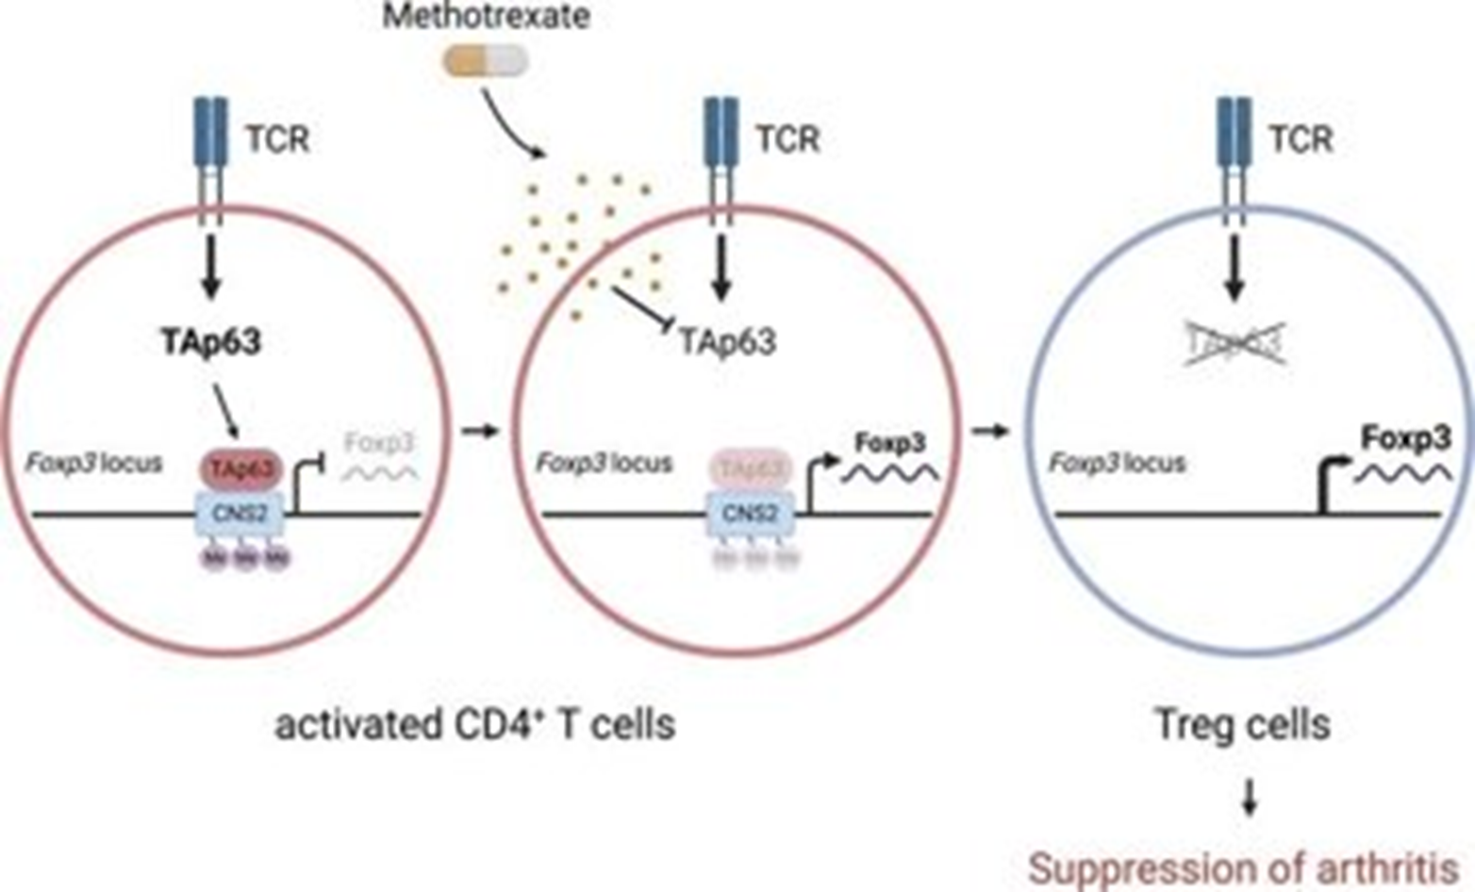

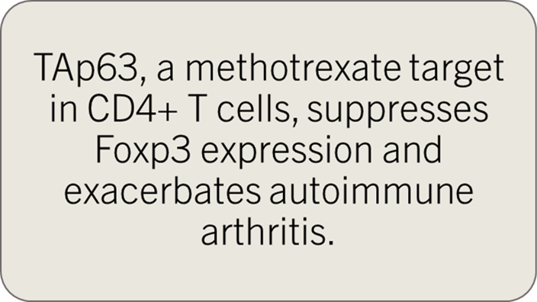
Autoimmunity and Treg
Autoimmunity, the state in which the immune system reacts against the body’s own normal components, producing disease or functional changes.
Regulatory T cells are gatekeepers of tolerance. Tregulatory T cells in the context of autoimmune diseases causing rheumatoid arthritis.
They maintain tolerance, prevent autoimmune diseases and are characterized by expression of CD4, CD25 and Foxp3.
Autoimmunity and Treg

Slide 3

Methotrexate Drug Side Effects
Black, tarry stools
Bleeding gums
Blood in the urine or stools
Bloody vomit
Diarrhea
Increased heartbeat
Itching, rash, reddening of the skin
Joint pain
Stomach pain
Nausea
Pinpoint red spots on the skin
Swelling of the eyelids, face, lips, hands, feet, or lower legs
Swelling or inflammation of the mouth
Trouble breathing
Unusual bleeding or bruising
Vomiting
Yellow eyes or skin

Slide 4
Aim
Molecular Interactions between TP63 with Herbal compounds replacing Methotrexate for Rheumatoid arthritis.

Slide 5
Herbal compounds
Curcuma longa
Sophora flavescens
Marsdenia tenacissiame
Liquiritigenin

Slide 6

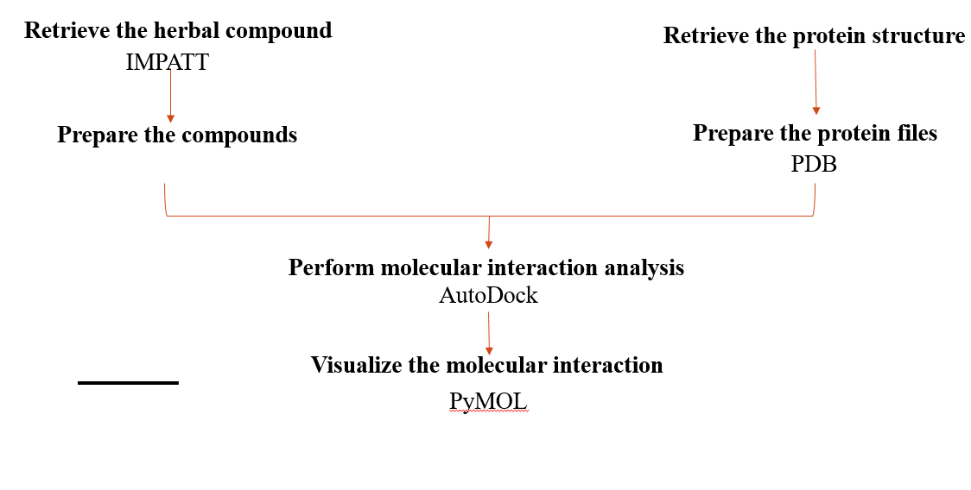

Methodology

Slide 7
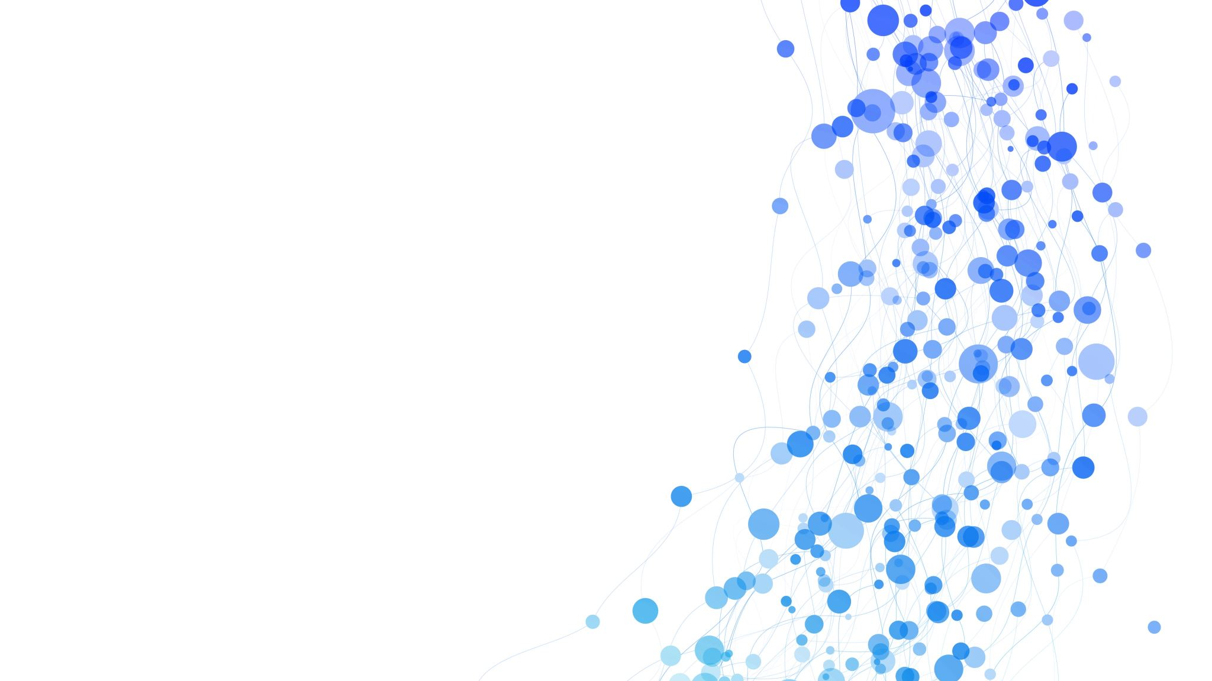
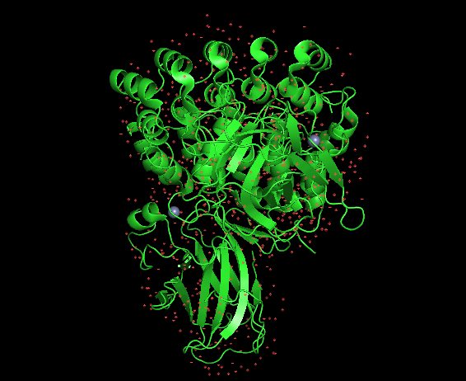
Retrieve the Protein structure
We retrieve this TAp63 protein in PDB Database.,
This picture is visualsization in PYMOL

Slide 8
Retrieve the herbal compound
We retrieve molecules of these herbal compounds from IMPATT, and save as suffix”.pdbqt”in reference with some related articles in PUBMED.
Curcuma longa-Curcumin(whole plant) IMPHY007574
Acalypha wilkesiana- Liquiritigenin(leaf)IMPHY001869
Sophora flavescens-Matrine(seed) IMPHY004247
Marsdenia tenacissiame-Tenacigenin B(seed) IMPHY010510

Slide 9

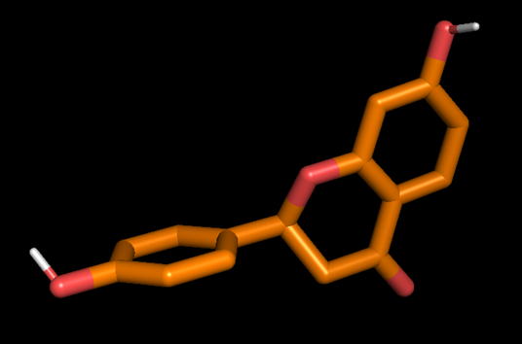

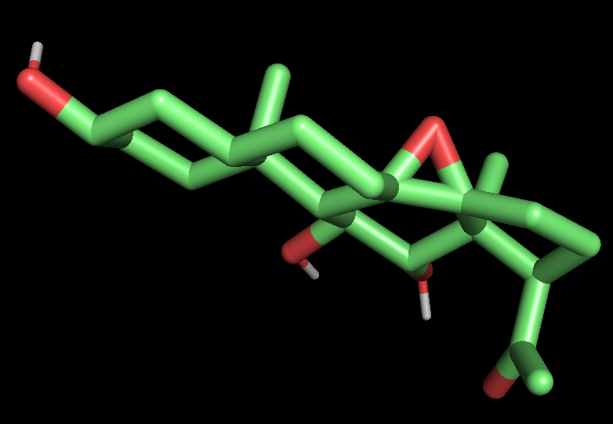

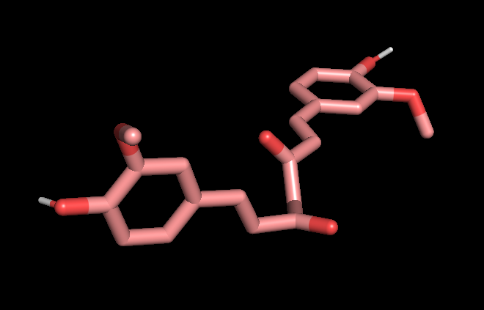
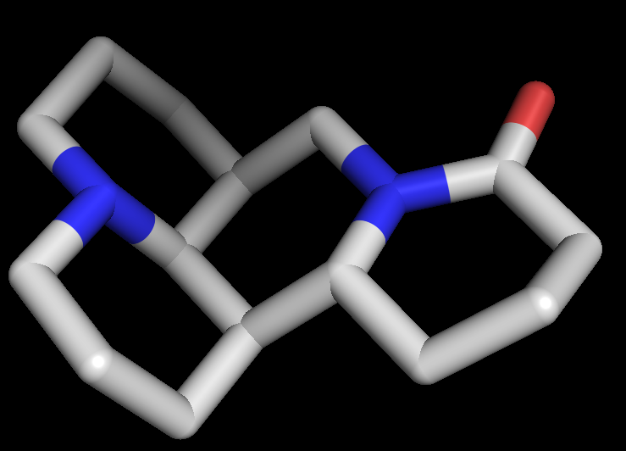
Herbal molecules Structures
Tanacigenin B
Curcumin
Liquiritigenin
Matrine

Slide 10
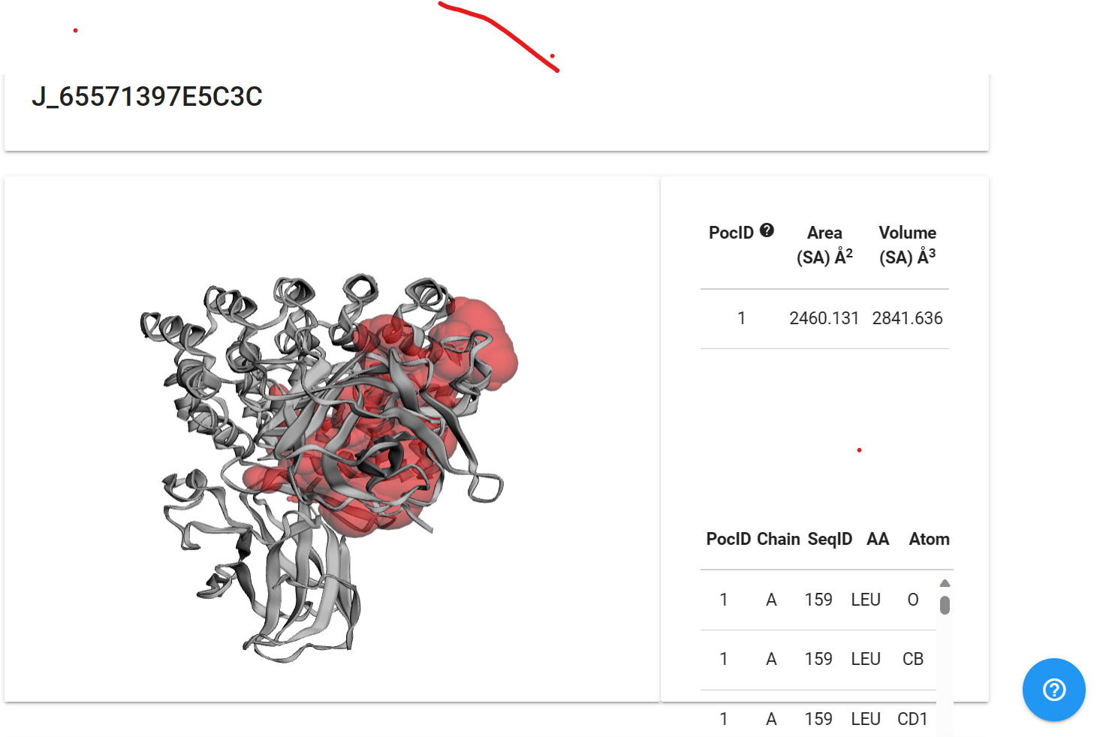
Prepare the protein files
Using CASTP ,we prepare our protein files by finding the active sites..

Slide 11
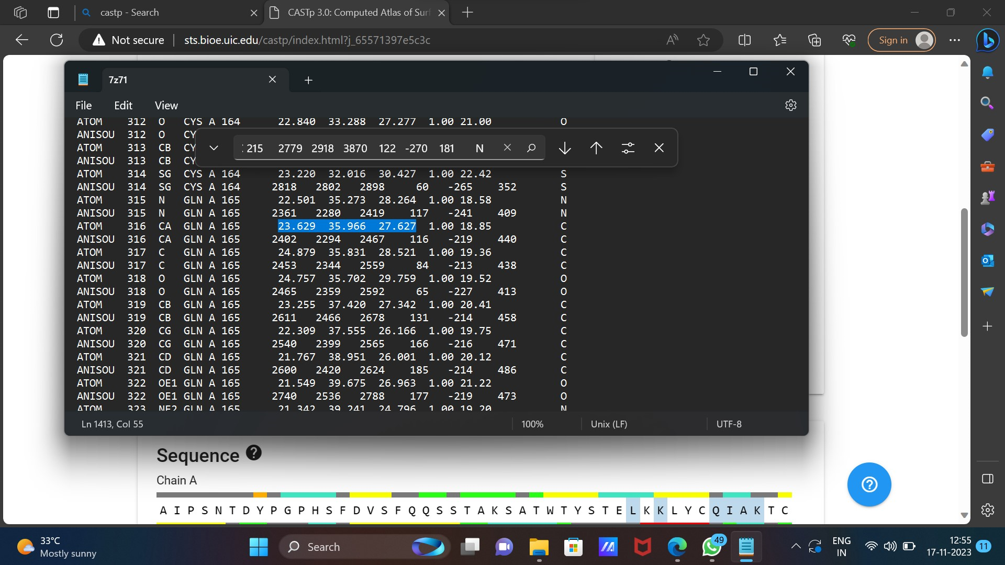
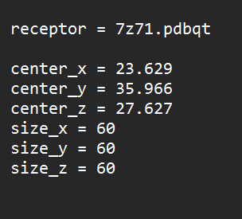
With retrieved actives sites, We need to take the coordinates for ligands binding..
COORDINATES

Slide 12
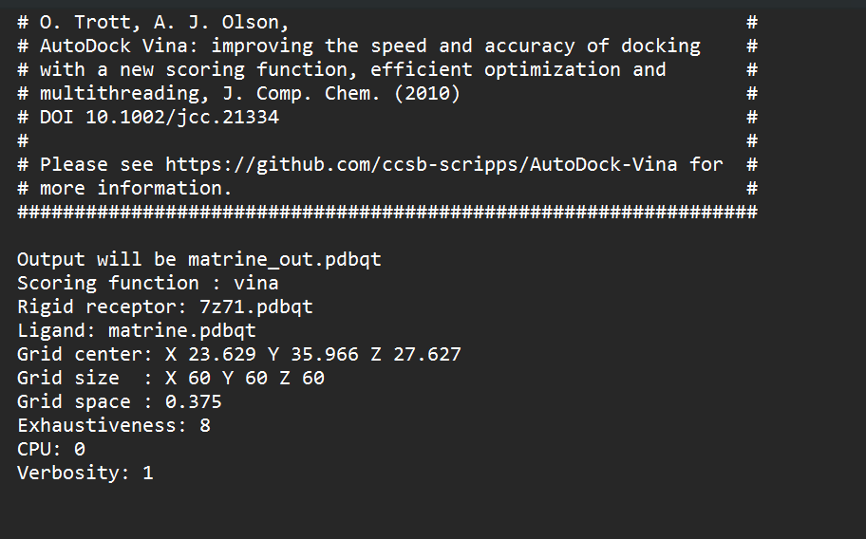
Perform molecular interaction analysis
Using AUTODOCK we perfrom Binding analaysis between the Protein and the Ligands.
To make it easy, we can also perform Multiple Autodock.

Slide 13
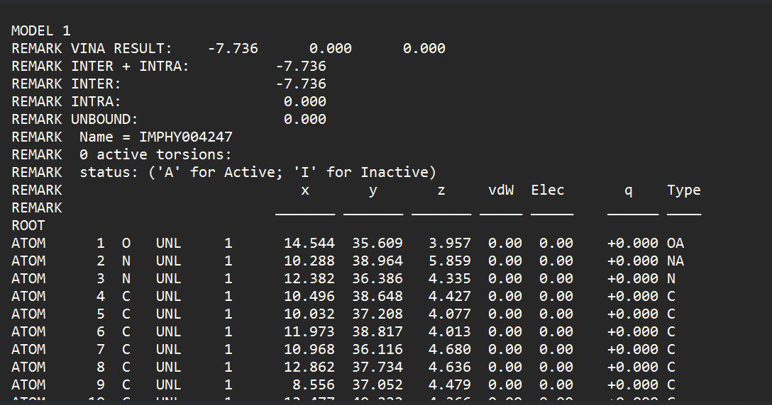
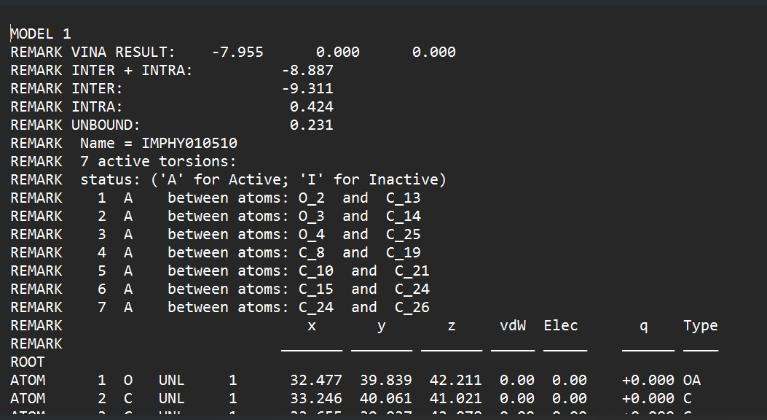
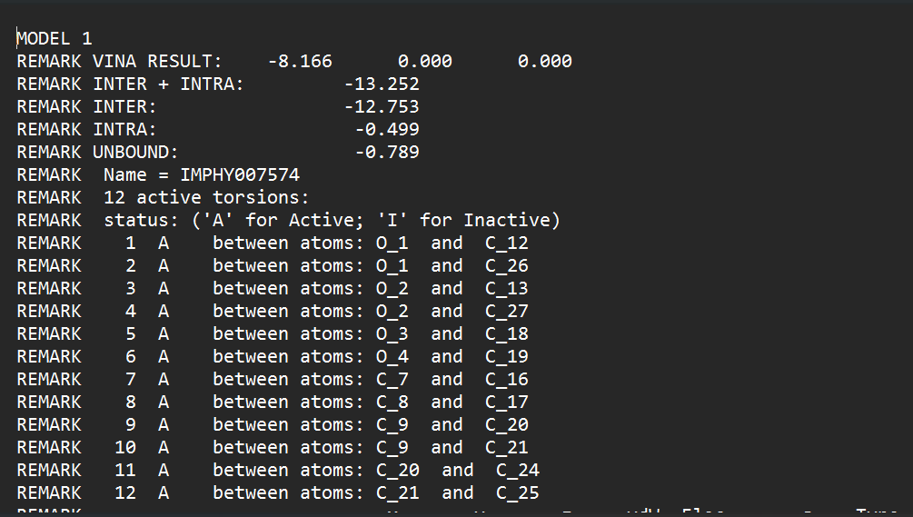
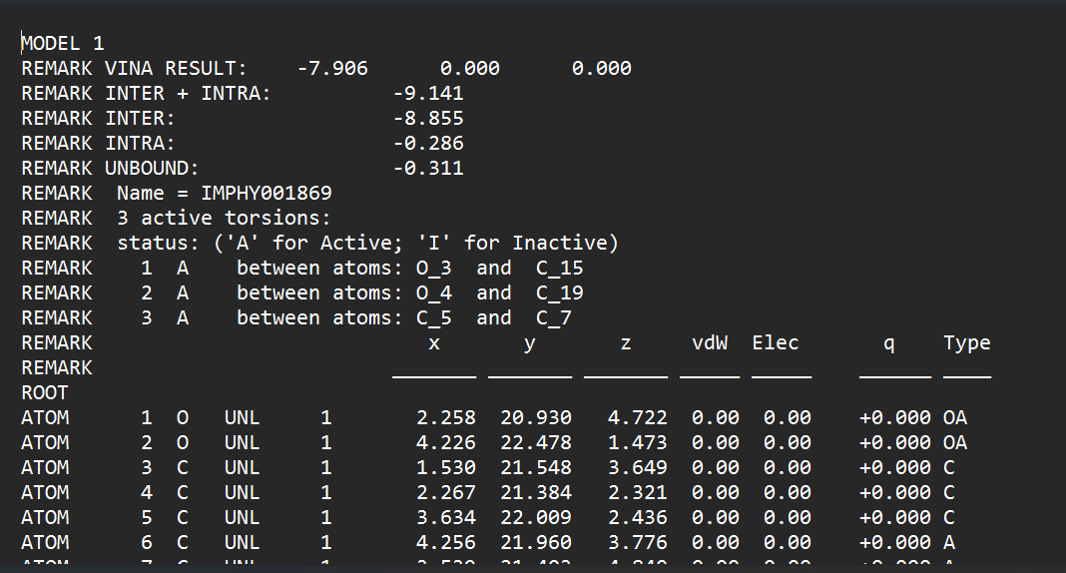
Outputs :
Sophora flavescens-Matrine
Marsdenia tenacissiame
Liquiritigenin
Curcuma longa-Curcumin

Slide 14
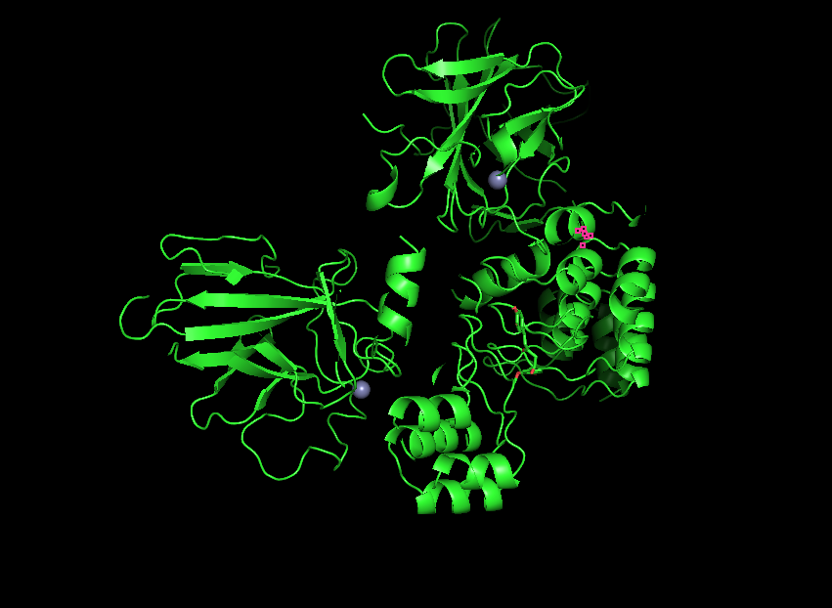
Visualize the molecular interaction
Using PYMOL, we can visualize the docked molecules output,
Curcumin

Slide 15
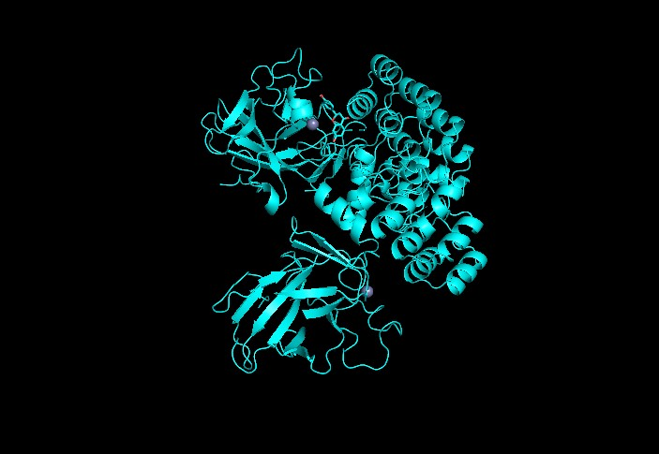
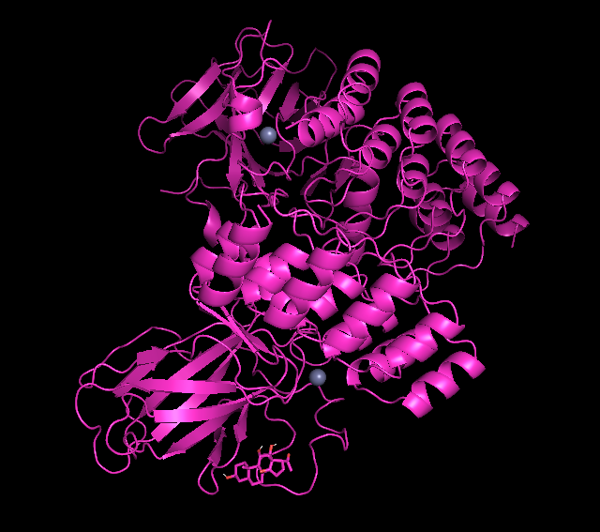
Acalypha wilkesiana
Marsdenia tenacissiame

Slide 16
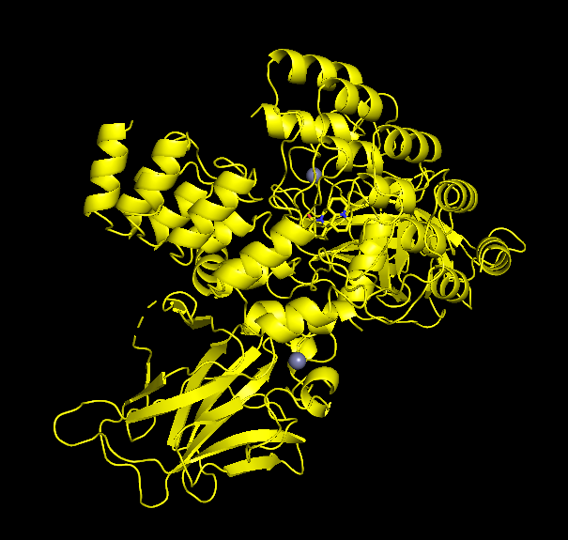
Matrine

Slide 17
Future Analysis:
I want to perform Simulations in these molecules and check with the compatibility.. So that in In-Vitro analysis also these molecules get good results for replacing Methotrexate drug for treatment of Rheumatoid arthritis Auto Immune disease.
Also want to check with some more molecules which can have high scores than these selected molecules…

Slide 18
Simulations
We need to perform - Protein ligand simulations.
Between the Autodocked resulted protein molecule with our TP63 Protein.
Making sure of all the files be prepared in PDB format.
AUTODOCKED PROTEIN
PROTEIN

Slide 19
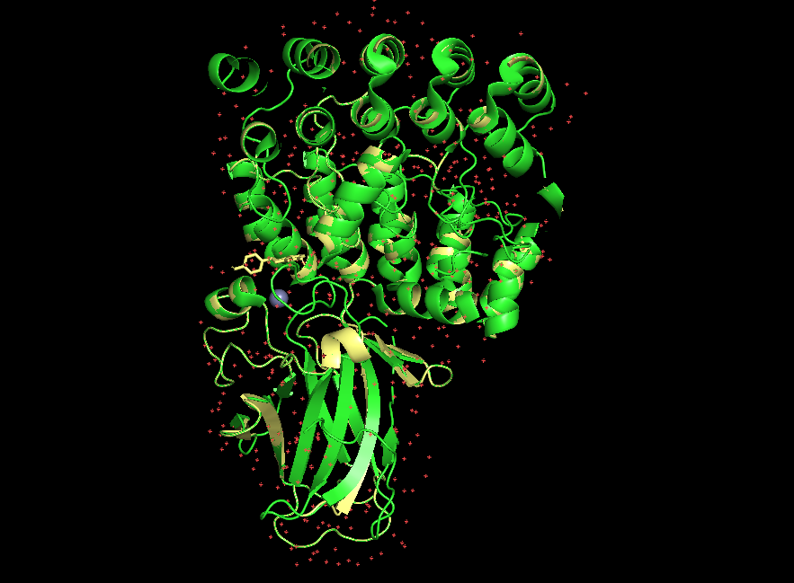
CUrcumin

Slide 20
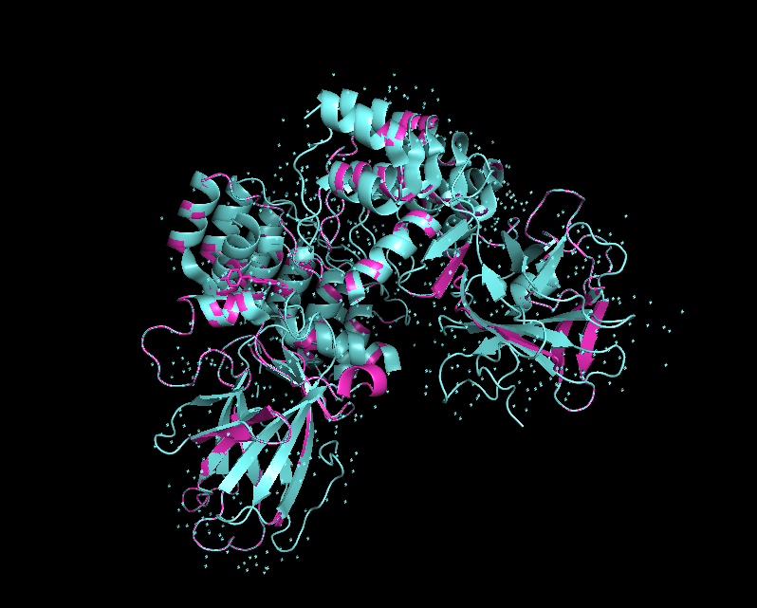
Acalypha wilkesiana

Slide 21
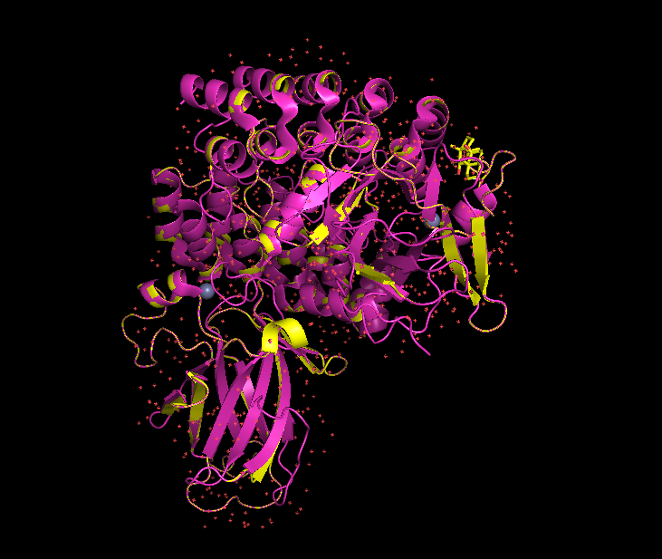
Marsdenia tenacissiame

Slide 22
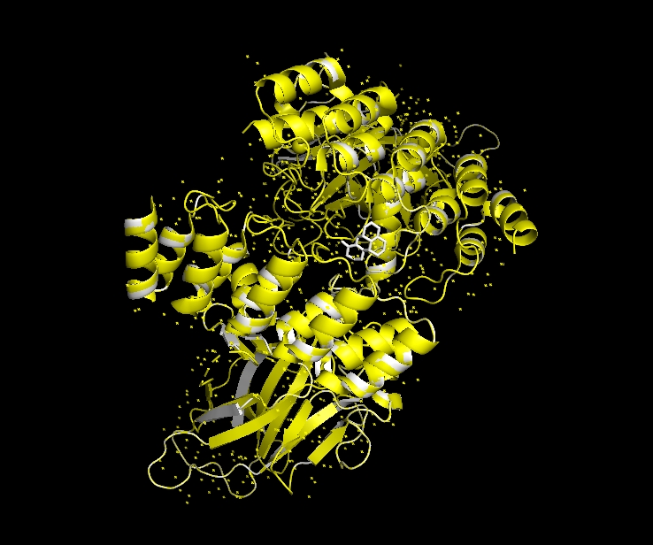
Matrine

Slide 23

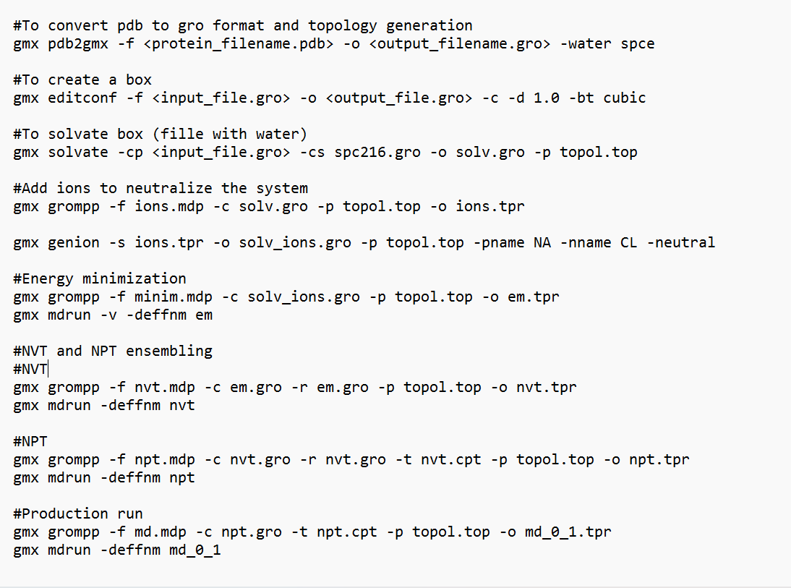

Steps:

